Slide 1
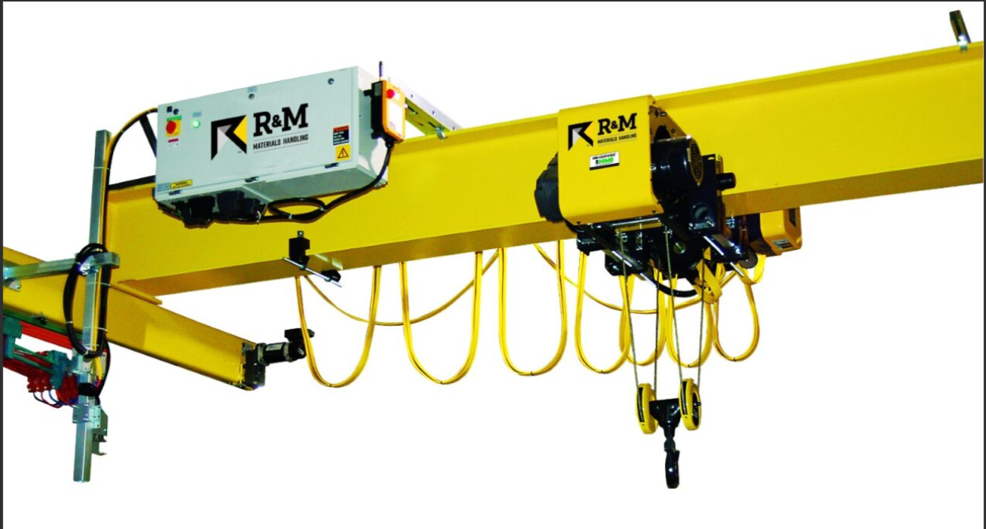
Gantry Crane Automation
Andrew Chappell
Caleb Douglass

Slide 2









Project Proposal: Concept

Slide 3
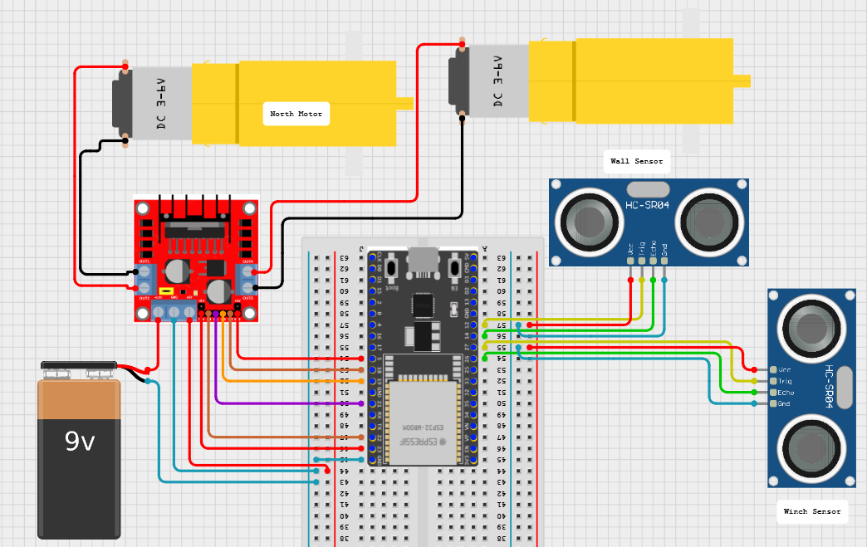
Wiring Diagram

Slide 4
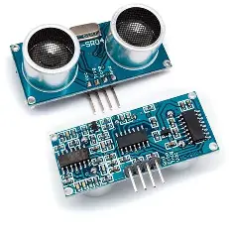
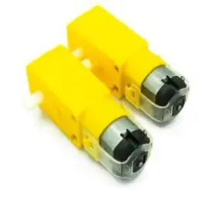
Sensors and Actuators
Sensors
Actuators
2x HC-SR04 Ultrasonic Sensor
2x 9V DC Motors

Slide 5
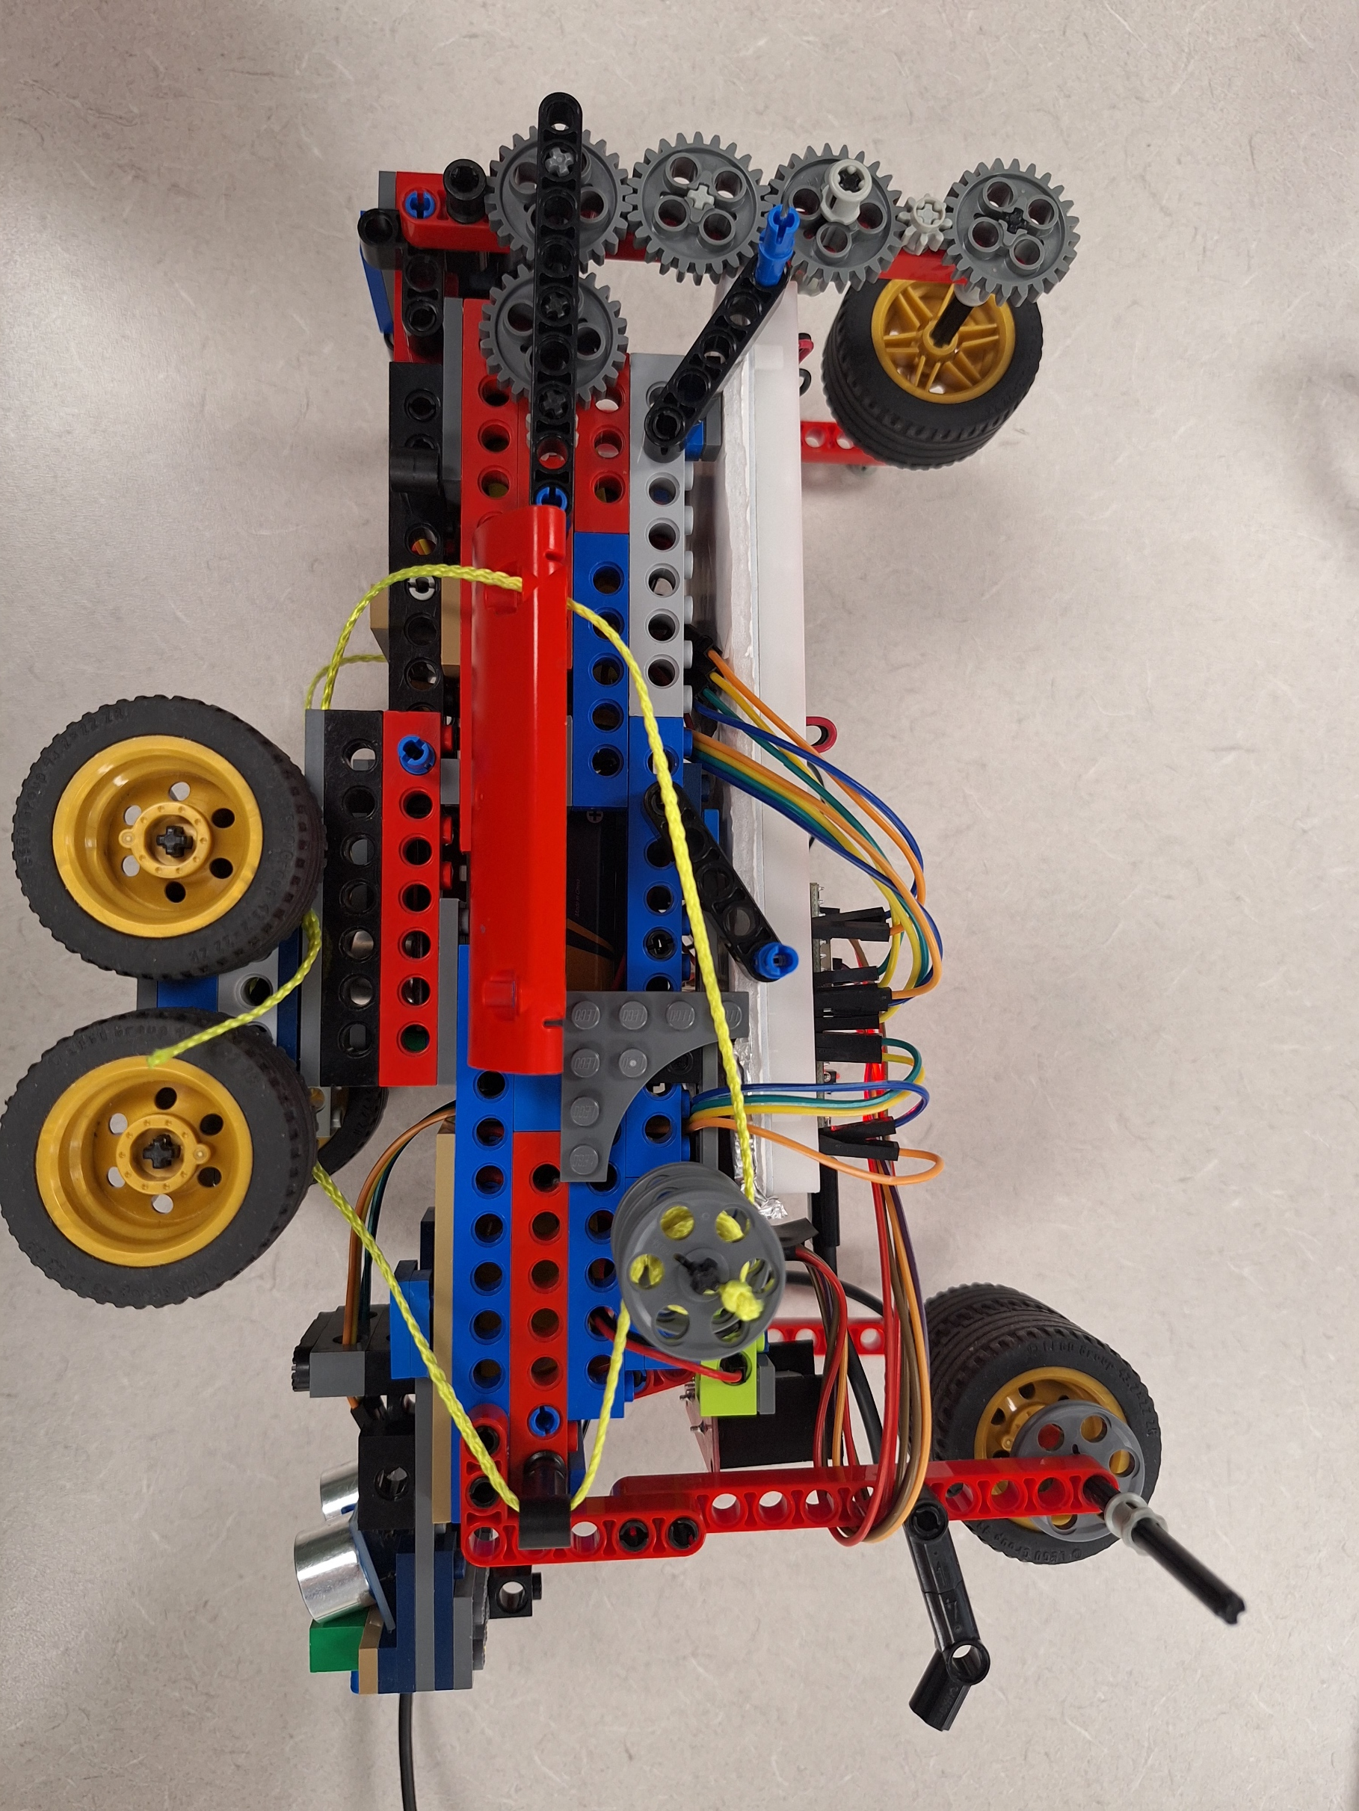
Hardware

Slide 6
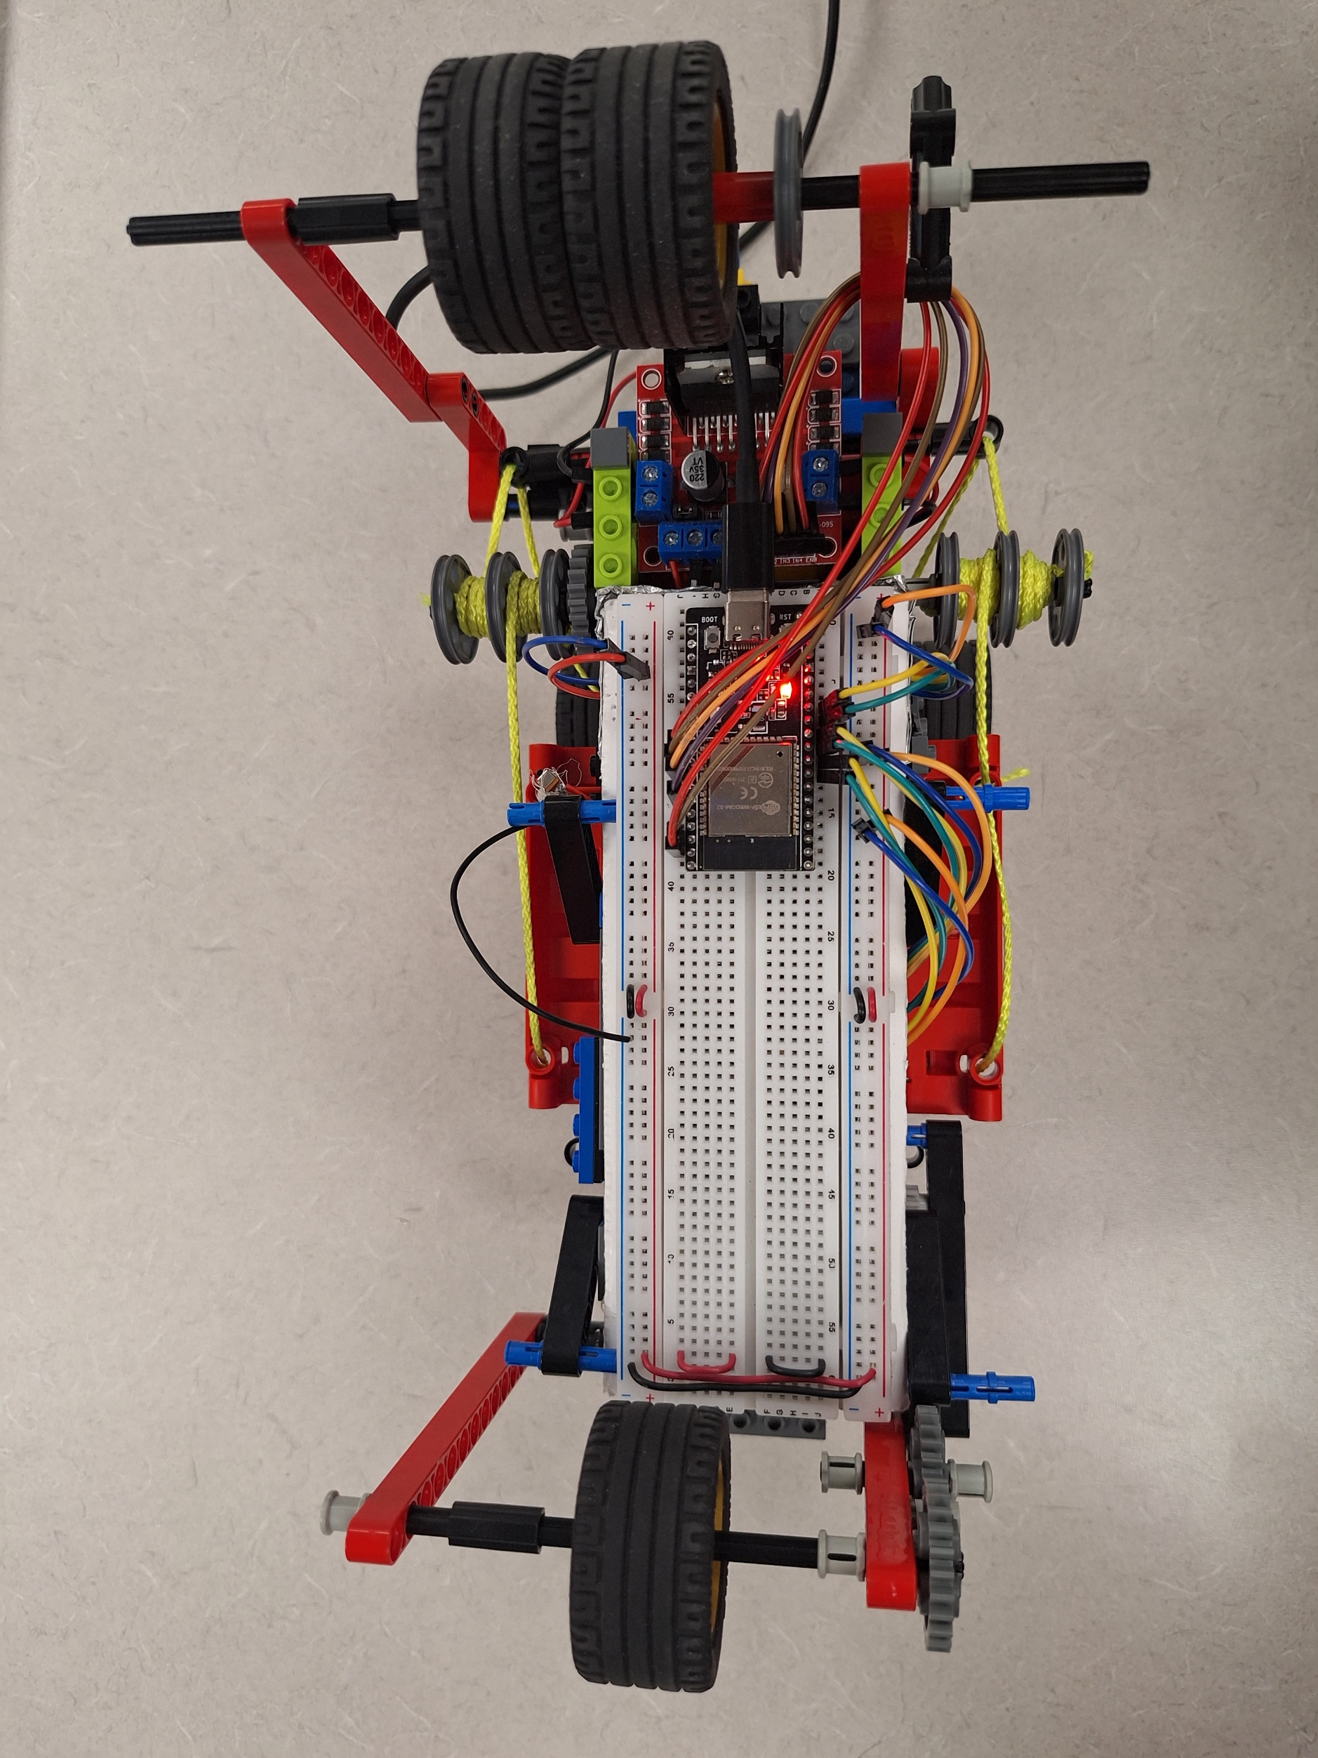
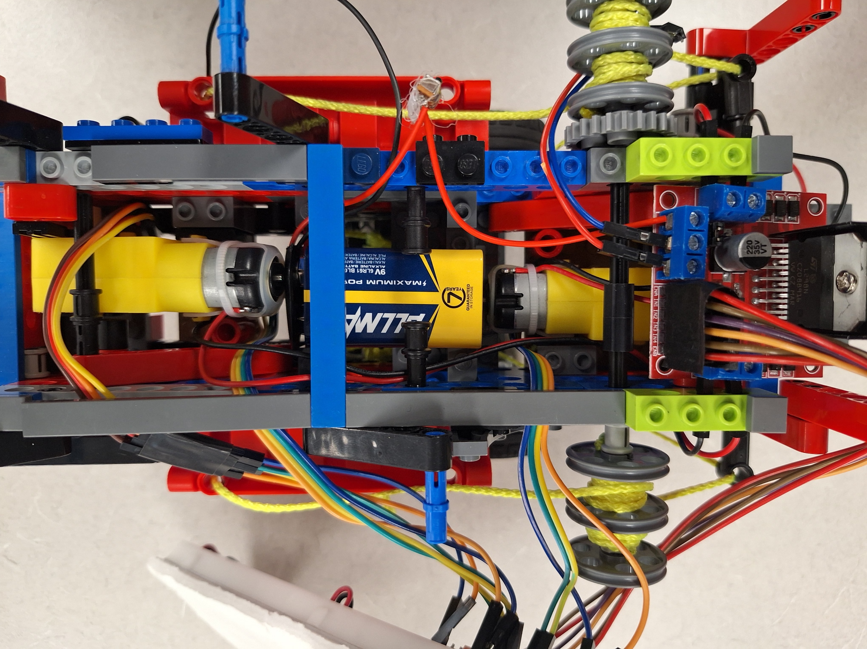
Hardware (cont)

Slide 7
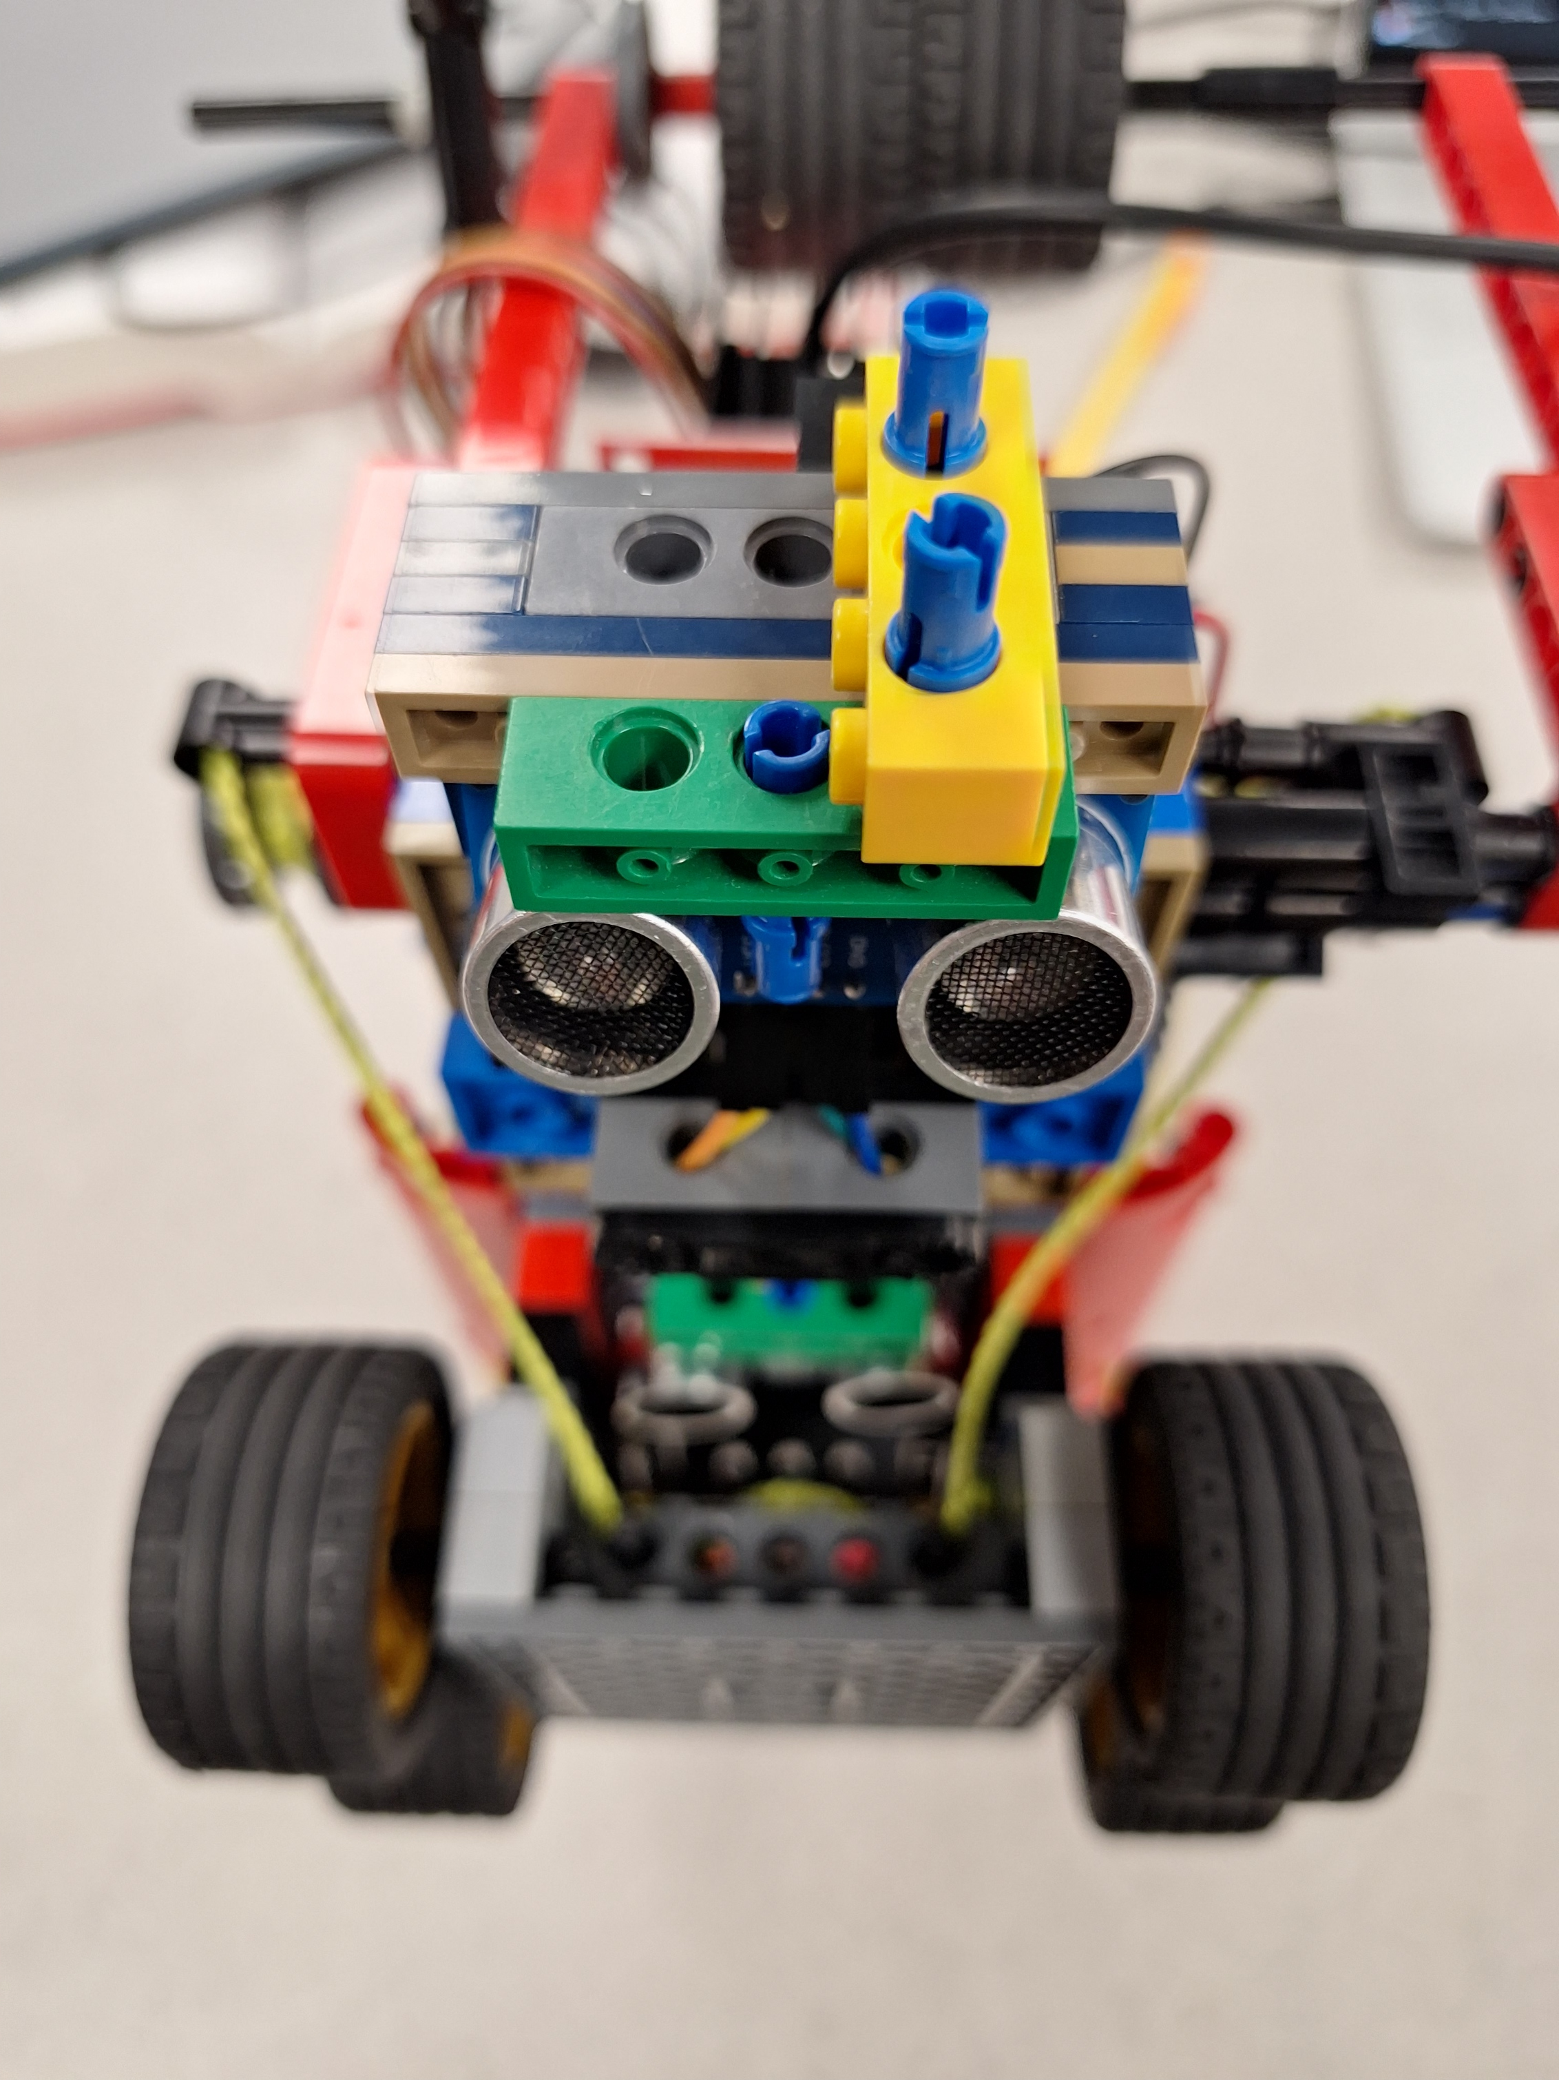
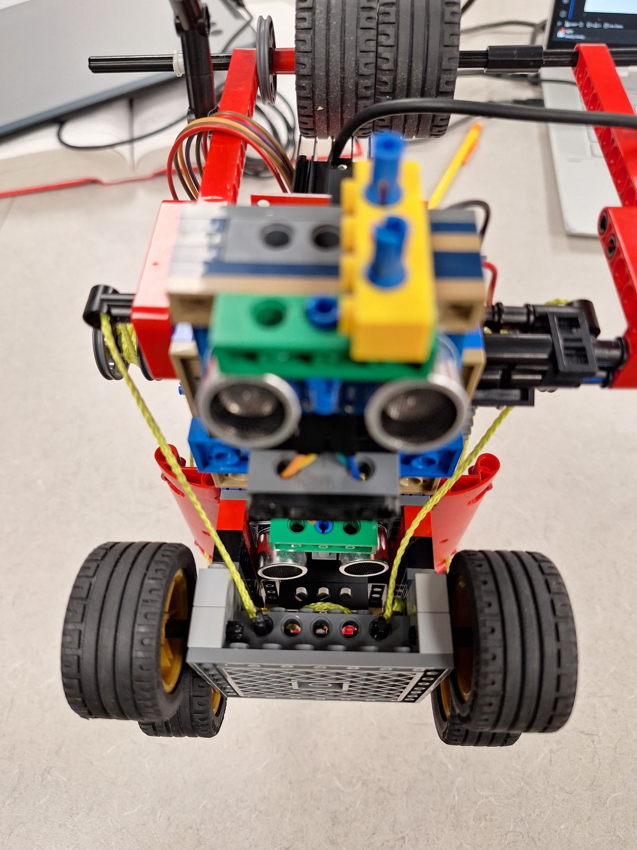
Sensors

Slide 8
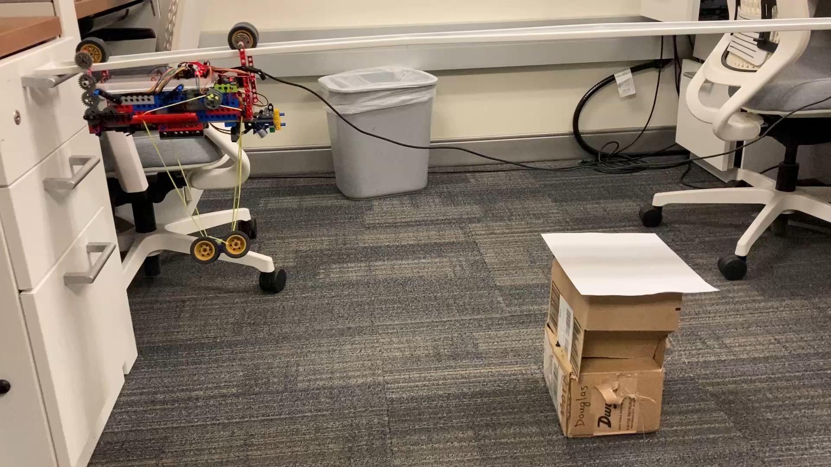

Slide 9
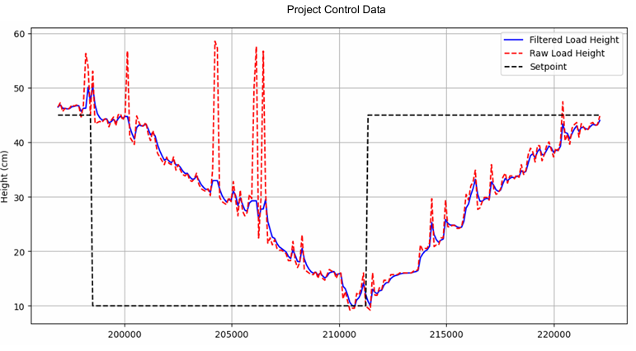
Disturbance Rejection

Slide 10
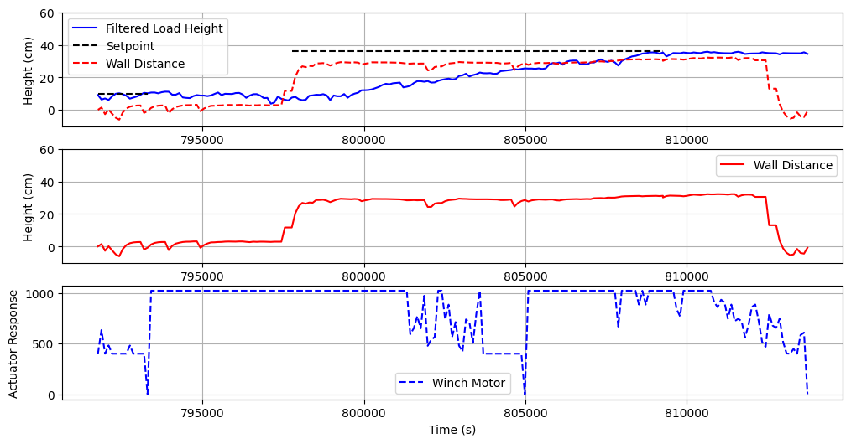

Slide 11
